Slide 1
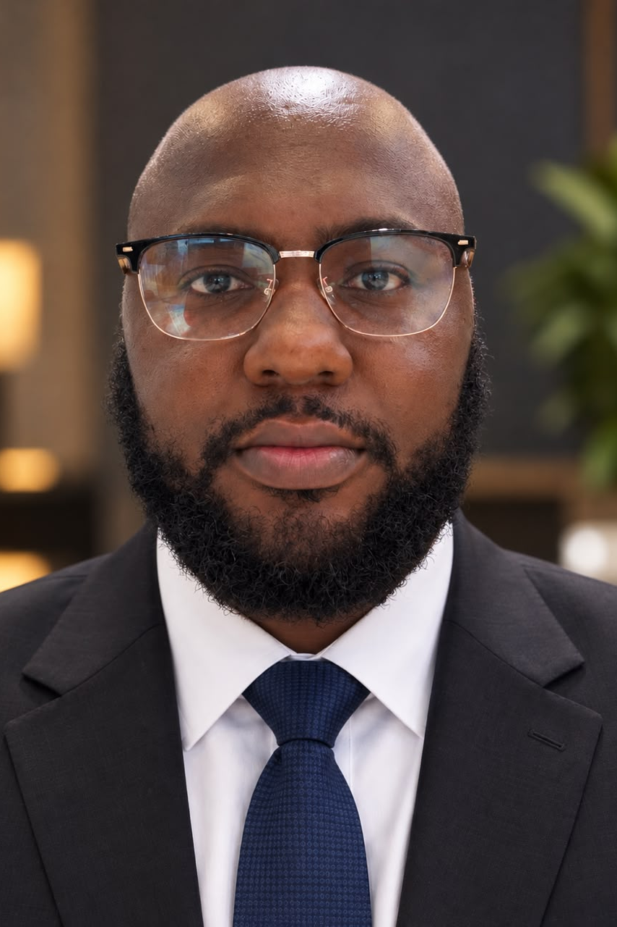
Ikegbunem Ugochukwu
Founder & Chief Executive, One100 Group
Production Manager, Macnico Enterprises
Ifite Awka, Anambra State
Ugochukwu.ikegbunem@gmail.com
+234 905 550 6058
Notes:
Open with who you are: founder of a four-company group, and the production manager running FamilySearch's oral genealogy work in Nigeria.

Slide 2
PROFILE
Operator and founder who builds and runs multi-sector businesses end to end — from field production under an international client's standards to a four-company group built from first customer to standing operation.
283
4
6
1st
People employed across One100 Group and FamilySearch contracts
Companies founded and led
West African countries audited
Nigerian contractor awarded Gold recognition
Notes:
The through-line: build the operation, then hand it a standard it can run on. Four numbers carry the story.

Slide 3
FOUNDER & CHIEF EXECUTIVE · PRESENT
One100 Group
Sets strategy, capital allocation and leadership across every operating arm; built each subsidiary from first customer to standing operation.
One100 Services Limited
One100 Farms & Foods
Logistics, data collection and analytics.
Livestock farming and catering services.
One100 Nest Limited
One100 Design & Automation
Real estate investment and development.
Design build and automation systems.
Notes:
Four operating arms, one holding company. Note that the group supports 219 people directly and indirectly.

Slide 4
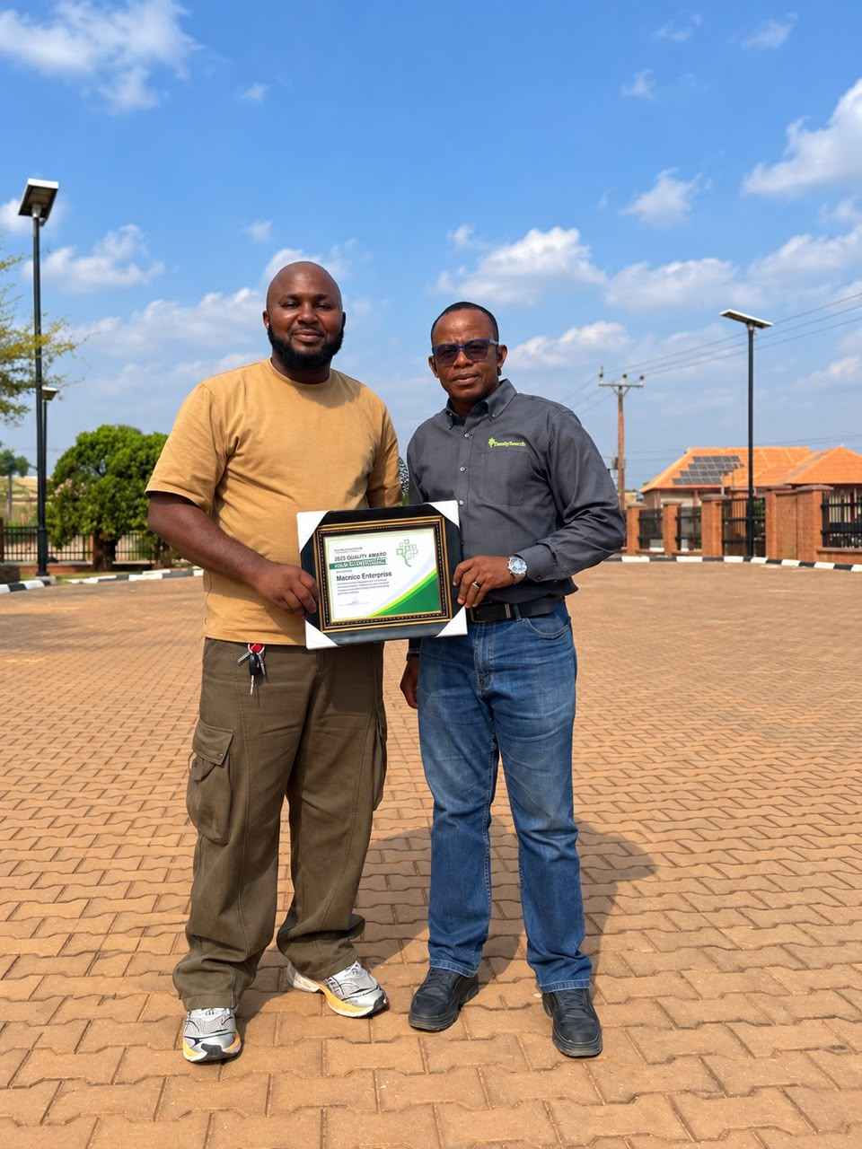
FAMILYSEARCH INTERNATIONAL · MACNICO ENTERPRISES
Production at an international standard
Adopted worldwide
Gold recognition
Designed and implemented a standard collection process later taken up by FamilySearch International globally.
First Nigerian contractor to win the organisation's Gold recognition for quality of work.
Staff of 64
Oral genealogy production
Employed and managed 64 staff plus subcontractors, delivering on schedule and with no injuries on site.
Runs field recording, transcription and data handoff for the programme, managing teams and schedules across sites.
Gold recognition, 2025 Quality Award — presented by FamilySearch country manager Engr. Ogbonnaya Okoro.
Notes:
The client-facing record: a collection process adopted worldwide, and the first Nigerian contractor to earn Gold recognition.

Slide 5
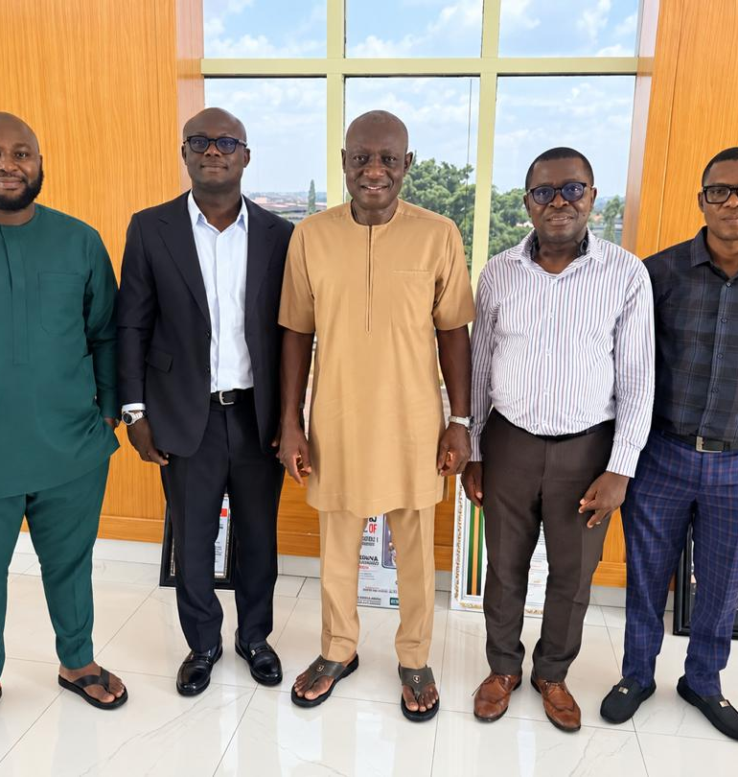
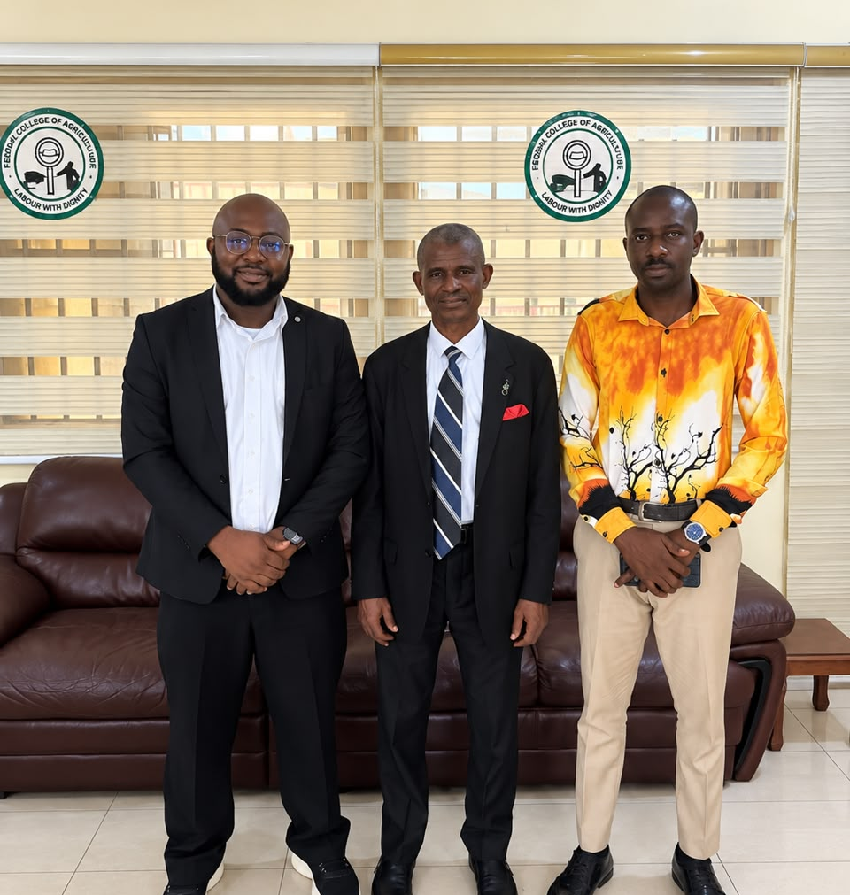
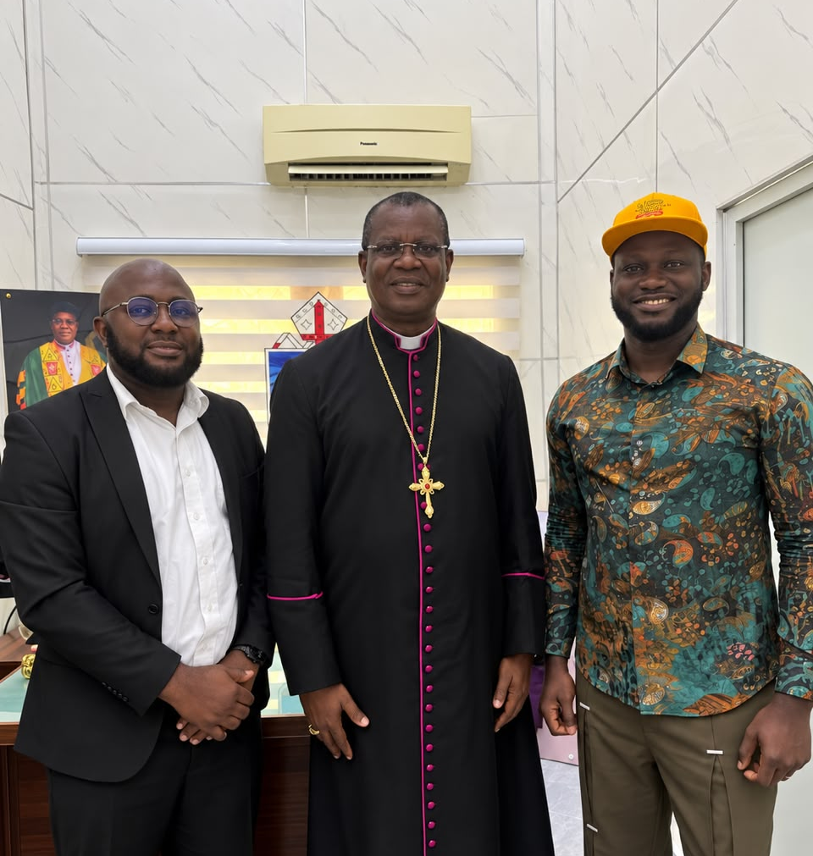
FAMILYSEARCH INTERNATIONAL · SCAN & SHARE · PRESENT
Digitising institutional records
Helps institutions move their archives off paper under a second FamilySearch contract — survey, scanning, quality control and handoff — and builds the partnerships that open each site.
PARTNERSHIPS IN DEVELOPMENT
Nnamdi Azikiwe University
Chukwuemeka Odumegwu Ojukwu University & Teaching Hospital
UNTH Enugu
Prof. Obinna D. Onodugo, Chief Medical Director, UNTH Enugu.
Dr. Nwawuisi Jonah Umunnah, Provost, Federal College of Agriculture, Ishiagu.
Rt. Rev. Dr. Owen Chiedozie Nwokolo, Bishop on the Niger, Anglican Church.
Federal College of Agriculture, Ishiagu · further sites in the pipeline
Notes:
Second FamilySearch contract: digitising institutional records, with university and hospital partnerships being built now.

Slide 6
EARLIER RECORD
Auditor
Audited project finances and operations across Nigeria, Ghana, Sierra Leone, Liberia and Senegal; ran unannounced compliance checks and introduced faster auditing procedures.
FamilySearch International
Volunteer Clerk
Oversaw Enugu's migration to online leadership and clerk resources, and trained clerks and incoming leaders on the systems.
Enugu · 2017 — 2019
Full-time Missionary
Responsible for 200+ fellow missionaries; learned Ibibio, Krio and Mende to teach each community in its own language.
Nigeria & Sierra Leone · 2014 — 2016
Notes:
Audit across six countries, then the church roles: digital migration in Enugu, and leading 200+ missionaries while learning three languages.

Slide 7
EDUCATION
CAPABILITIES
Nnamdi Azikiwe University
Business strategy · Vision & product development · Product design · Team building · Public speaking · Production management · Field operations · Data collection & analytics · Logistics · Client & contract management · P&L ownership
BSc Economics — in progress
2025 — 2030 (expected)
Nigerian College of Aviation Technology, Zaria
Aircraft Maintenance Engineering — one of 15 admitted from 2,009 candidates
2018 — 2019
LANGUAGES
Annunciation Secondary School, Enugu
English · Ibibio · Krio · Mende — each learned to teach and work in the community that speaks it. Spanish in progress.
SSCE — NECO
2007 — 2013
Notes:
Economics in progress; the Zaria admission is the standout — 15 of 2,009. Close on capabilities and languages.

